Slide 1
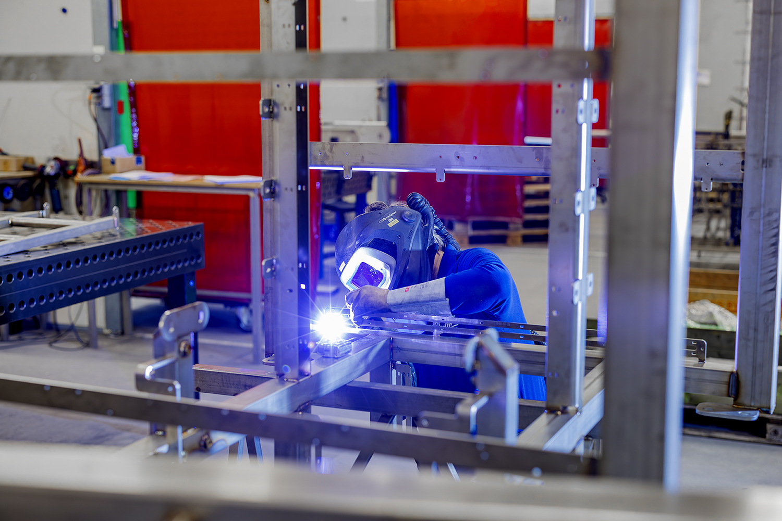
Toolbox Welding fumes
Company name and date

Slide 2

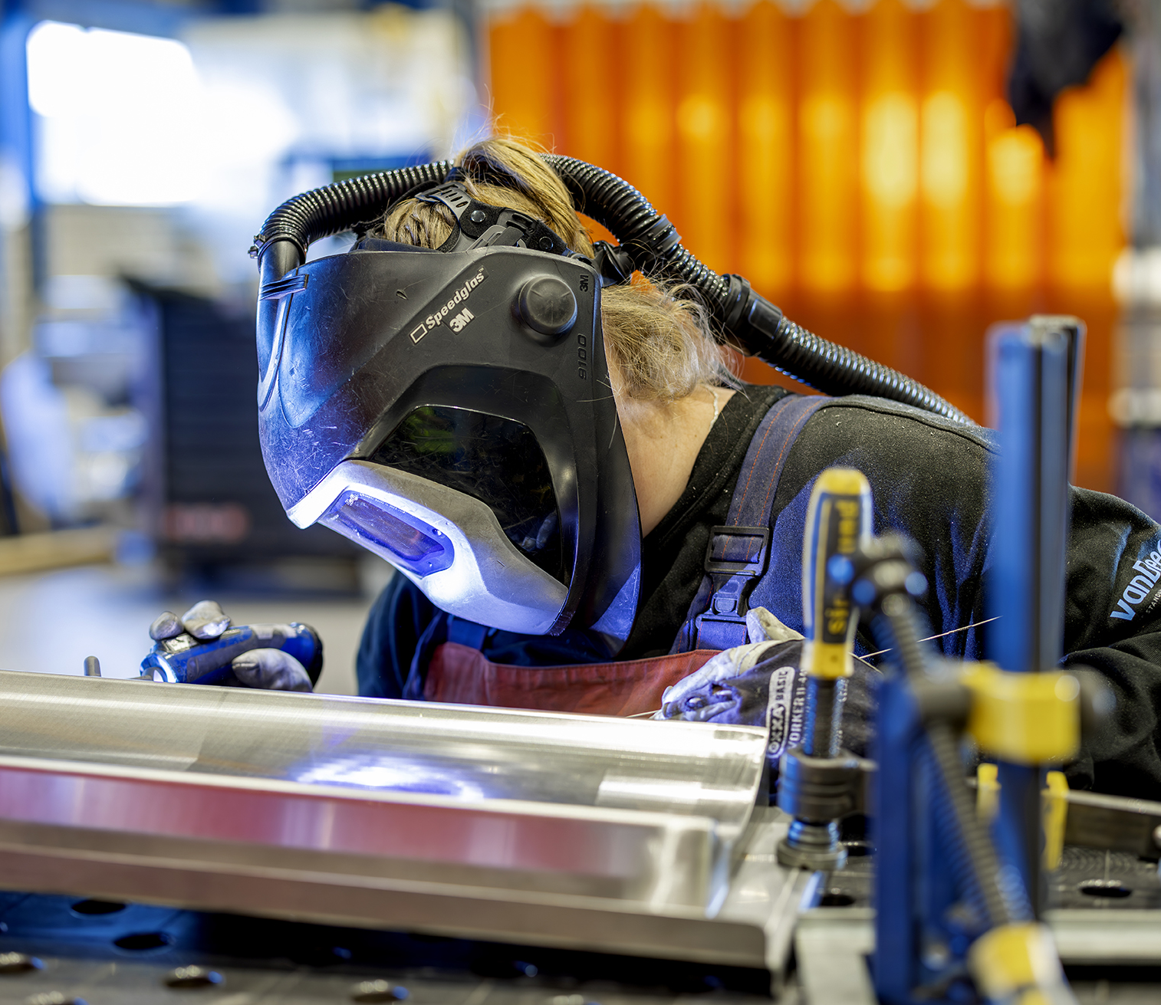
Contents
Safe and healthy working practices | Welding fumes
What are the risks of welding fumes?
What are the rules?
What can you do yourself?
What are the risks of grinding dust?

Slide 3
Welding fumes are a mixture of:
Safe and healthy working practices | Welding fumes
What are welding fumes?
Welding stainless steel produces chromium-6, a highly toxic substance that can cause cancer
To limit the risks of welding fumes, measures such as good source extraction, ventilation, extraction systems and the use of personal protective equipment are essential.
gases
vapours
very fine particles
released during welding

Slide 4
Materials, techniques and additives such as wire and electrodes determine the composition of welding fumes. In addition, welding fumes often contain particles of paint, primer, grease and oil that are present on the workpiece.
Safe and healthy working practices | Welding fumes
What are welding fumes?
Welding techniques with the highest amounts of carcinogenic substances include:
MAG welding
flux-cored wire welding (without shielding gas)
autogenous plasma cutting
Stainless steel: Chromium is a component of stainless steel, and the welding process produces chromium-6.
Notes:
1 mg applies to normal welding processes, stainless steel is even less because of Chromium 6 (carcinogenic).

Slide 5
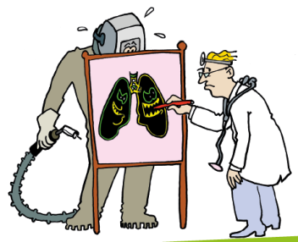
Safe and healthy working practices | Welding fumes
Health and welding fumes
Excessive exposure can lead to:
acute irritation of the respiratory tract
dizziness
metal fume fever
Prolonged exposure can cause more serious illnesses such as:
lung cancer
asthma
Note: the fine dust particles from welding fumes penetrate deep into the lungs. Any deposit in your lungs, stays there!

Slide 6
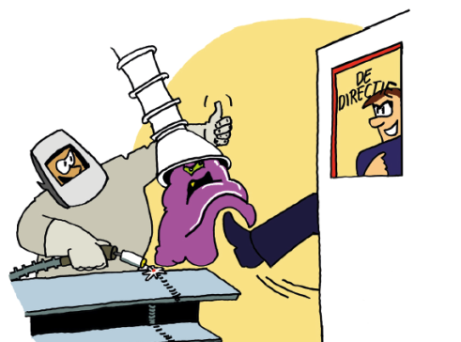
Safe and healthy working practices | Welding fumes
What does the Working Conditions Act say?
The limit value for welding fumes is 1 mg/m³.
For stainless steel welding fumes containing chromium-6, a lower limit value of 1 µg/m³ applies.
Employer obligations:
protect employees (start at the source)
assess exposure = calculation model or measurement
Employee obligations:
follow employer's instructions.
Use PPE.
Notes:
1 mg applies to normal welding processes, stainless steel is 1 µg/m3 due to Chromium 6 (carcinogenic). µg per m3 = microgram per cubic meter.

Slide 7
Safe and healthy working practices | Welding fumes
What does the Working Conditions Act say?
Assess exposure:
measurement in accordance with standard
use an approved calculation model: the Improvement Check of 5xBeter.
Improvement Check of 5xBeter:
approved calculation model
enter scenario
check against limit values
action plan with areas for improvement
Requirement from the Improvement Check = mechanical space ventilation:
Operating time <15% = 800 m³ per hour per welder.
Operating time >15% = 1600 m³ per hour per welder.
Notes:
Mechanical room ventilation: all welding fumes not removed at the source will be released into the room. To protect everyone in the room (including colleagues who are not welders), room ventilation is necessary to provide clean air.

Slide 8
Safe and healthy working practices | Welding fumes
How do we do it?
I wait 5 seconds before taking off
my welding helmet.
Agree? Hands in the air!
Notes:
Always wait 5 seconds for the smoke plume to disappear.

Slide 9
Safe and healthy working practices | Welding fumes
Statement
I weld with my head
in the welding fumes.
Disagree? Hands in the air.
Notes:
Head in the plume: This occurs when the welder's head is regularly in the visible plume.
This is due to the leakage rate of welding helmets. Furthermore, a regular welding helmet or hand-held hood is not a respiratory protective device.

Slide 10
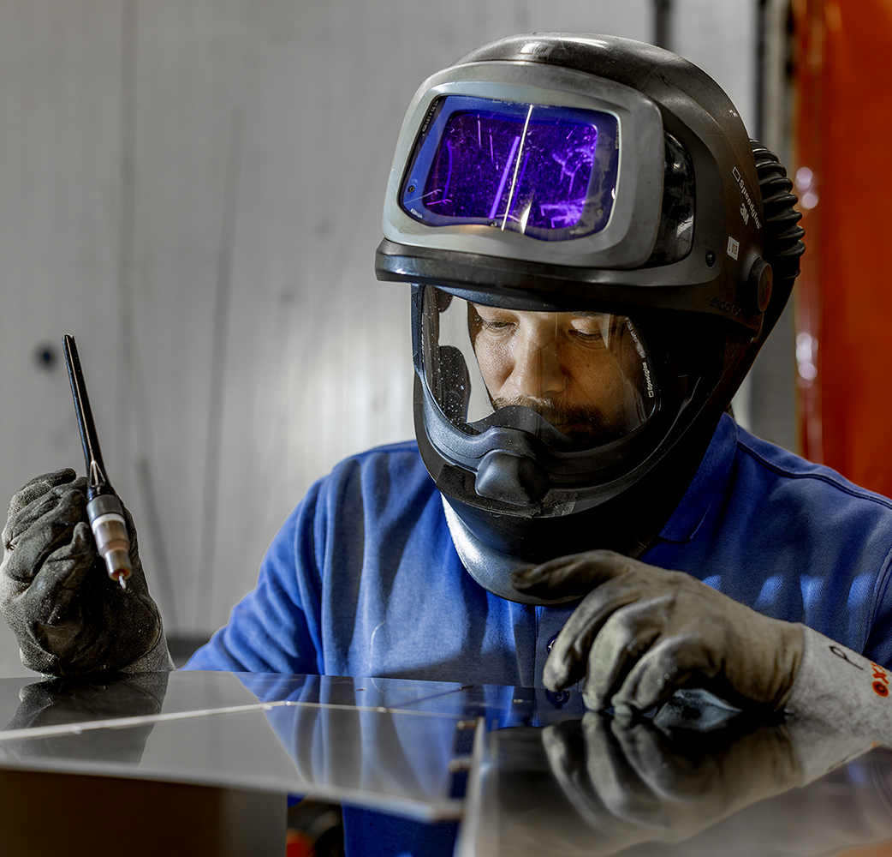
Safe and healthy working practices | Welding fumes
How is it done here?

Slide 11
Safe and healthy working practices | Welding fumes
Statement
I use the source extraction properly
if it is never more than 1 metre away from the weld.
Yes, agree.
No, disagree.
Notes:
Source extraction is only effective when the distance between the extraction nozzle and the weld is equal to or less than the diameter of the extraction nozzle.

Slide 12
Safe and healthy working practices | Welding fumes
Statement
I alert my colleague
to the use of source extraction.
Yes, agree.
No, disagree.

Slide 13
Safe and healthy working practices | Welding fumes
How is it done here?

Slide 14

Explanation of source extraction statement
Notes:
Note: The video is nice, but I think it assumes 3.5 mg/m³... and the extractor fan is hung a bit clumsily.

Slide 15
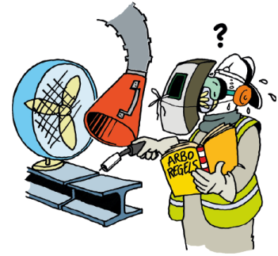
Safe and healthy working practices | Welding fumes
What can you do before you start welding?
Check whether there are other joining techniques.
Check that the welding equipment and extraction are correctly adjusted.
Check that the material is clean, free of paint residues, oil, etc.
Check the (source) extraction, filters and respiratory protection

Slide 16
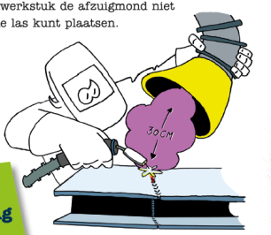
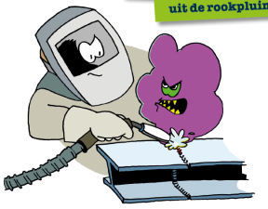
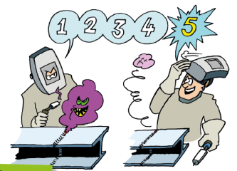
Safe and healthy working practices | Welding fumes
When you start welding
Source extraction
Head out of the plume
5-second rule

Slide 17
Safe and healthy working practices | Welding fumes
Grinding
Grinding dust released when working with an angle grinder can be harmful to health.
This is particularly true in the case of prolonged exposure.
Grinding dust consists of very fine particles that can easily be inhaled and penetrate deep into the lungs.
The material being ground may contain metal particles, silicon, or even harmful substances such as lead.

Slide 18
Safe and healthy working practices | Welding fumes
Grinding
Health risks
Long-term effects
In addition to the acute effects, prolonged exposure to fine dust can cause lung damage and increase the risk of lung cancer.
Respiratory problems
Irritation of the respiratory tract
Coughing
Conditions such as bronchitis and asthma
Skin and eye irritation
Grinding dust can also cause skin and eye irritation, especially if protective clothing or safety goggles are not worn.

Slide 19
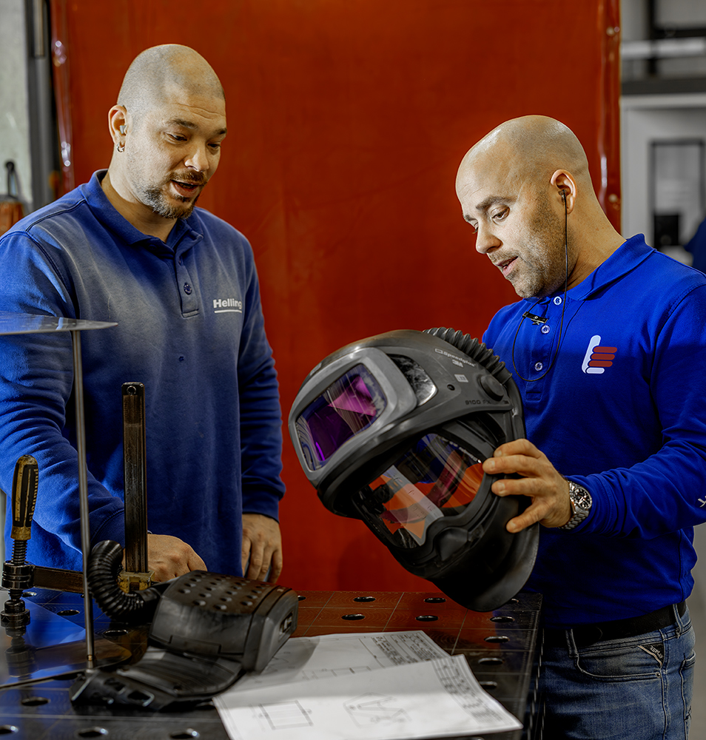
Safe and healthy working practices | Welding fumes
How is it done here?

Slide 20
Safe and healthy working practices | Welding fumes
Grinding
Protective measures:
Take appropriate protective measures during grinding, such as:
Use extraction systems or dust extraction at/near the grinder.
Wear a dust mask that provides adequate protection against fine particles (e.g. an FFP3 mask).
Wear safety goggles and protective clothing to prevent skin and eye contact.
Wear safety goggles and protective clothing to prevent skin and eye contact.
Notes:
Only a dust mask with sufficient protection against fine particles (e.g., an FFP3 mask) is recommended.
An FFP3 mask offers slightly higher protection than an FFP2 mask. The effectiveness of the filter mask depends primarily on its fit. It is important that the mask fits snugly against the face.

Slide 21
Safe and healthy working practices | Welding fumes
Statement
When grinding,
I usually wear a dust mask.
Yes, agree.
No, disagree.
Notes:
Another option: a positive pressure welding helmet with a grinding window. Half-face mask. Powered by a motor.

Slide 22
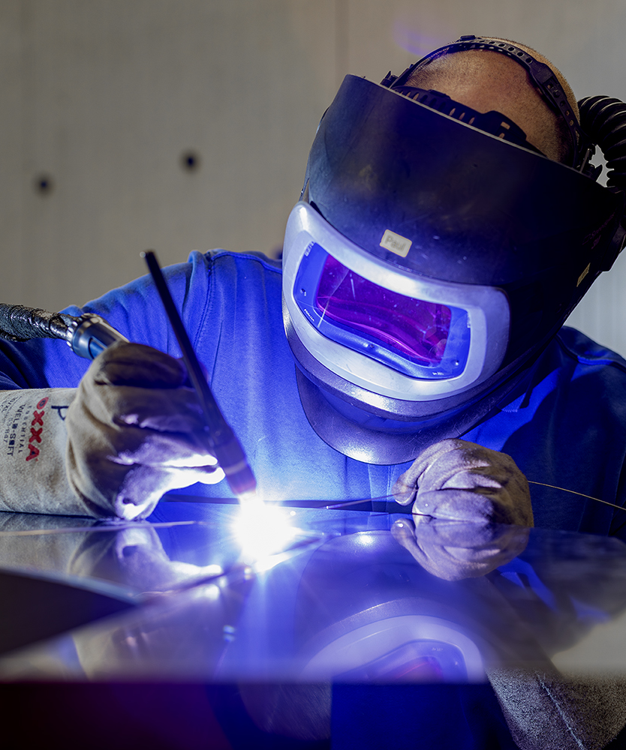
Safe and healthy working practices | Welding fumes
How is it done here?

Slide 23
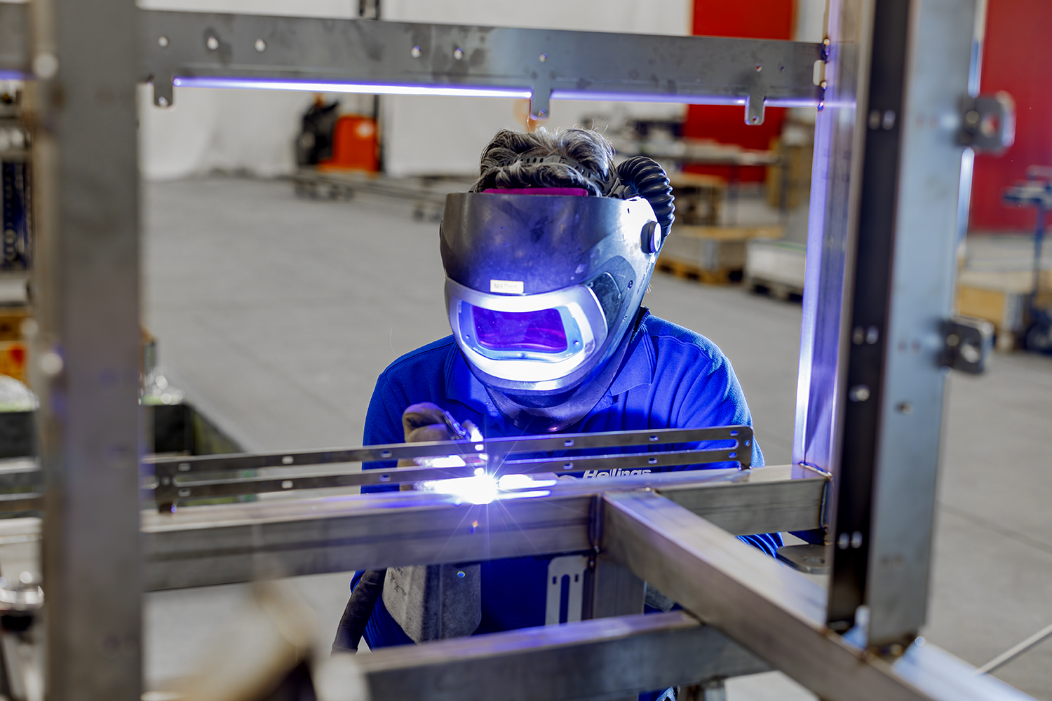
Safe and healthy working practices | Welding fumes
What can be improved here? What can you improve yourself?

Slide 24

Safe and healthy working practices | Welding fumes
Questions?
info@5xbeter.nl | www.5xbeter.nl

Slide 25
Safe and healthy working practices | Welding fumes
Need help?
Discuss it with your manager or contact the health and safety officer.
Consult an Improvement Coach from 5xbeter: www.5xbeter.nl
Or call the FREE Improvement Line: 0800 – 55 55 005
info@5xbeter.nl | www.5xbeter.nl

